Slide 1
Unit 4
Semantics

Slide 2
Requirements for Representation.
Expressiveness: Expressiveness refers to the ability of the representation system to capture a wide range of meanings, nuances, and contexts.
Rich Vocabulary: The system should have a rich set of symbols to describe various entities, actions, properties, and relationships.
Complex Structures: It should support the representation of complex structures such as nested and hierarchical relationships.
Context Sensitivity: The representation should capture context to accurately reflect meaning (e.g., the difference between "bank" in "river bank" and "financial bank").
Ambiguity Resolution: It should handle and resolve ambiguities in natural language.

Slide 3
Formalism: Formalism ensures that the representation has a well-defined syntax and semantics, allowing for unambiguous interpretation and processing.
Clear Syntax: The rules for forming valid expressions should be precise and unambiguous.
Defined Semantics: Each expression should have a clear meaning, defined in a way that machines can interpret consistently.
Standardization: Use of standard representation languages (e.g., First-Order Logic, Description Logic) can help in maintaining consistency and interoperability.

Slide 4
Inference: Inference capability allows the system to derive new information from existing knowledge, which is essential for reasoning and decision-making.
Logical Deduction: The system should support logical inference mechanisms such as modus ponens, modus tollens, and syllogism.
Probabilistic Inference: For handling uncertainty, the system might need to support probabilistic reasoning (e.g., Bayesian networks).
Temporal Reasoning: For applications involving time, the system should support reasoning about temporal relationships and events.

Slide 5
Propositional Logic
1. "If it is raining, then the ground is wet." - P → Q
2. "Either the system is down, or the network is slow." - P ∨ Q
3. "If the user is logged in and the session is active, then the user can access the dashboard." - (P ∧ Q) → R
4. "The application will fail unless it is updated." - ¬Q → P or P ∨ Q
5. "If the file is not found, an error message is displayed." - ¬P → Q6. "The server is running if and only if the power is on." - P ↔ Q
7. "If the temperature is above 30°C, then the air conditioner turns on." - P → Q
8. "If the database is backed up, the system will restart, and the logs will be cleared." - P → (Q ∧ R)
9. "If the user presses the submit button, then the form is validated and the data is sent." - P → (Q ∧ R)
10. "The document is either saved or discarded." - P ∨ Q

Slide 6
First-Order Logic (FOL),
First-Order Logic (FOL), also known as Predicate Logic or First-Order Predicate Calculus, is a formal system used to express statements about objects, their properties, and their relationships. FOL extends propositional logic by incorporating quantifiers and predicates, making it much more expressive.

Slide 7
Key Components of First-Order Logic
Terms:
Constants: Represent specific objects in the domain (e.g., a, b, Raju).
Variables: Represent any object in the domain (e.g., x, y, z).
Functions: Map a set of objects to another object
e.g., ‘fatherOf(Raju)’
Predicates: Represent properties or relationships between objects. For example,
Student(Raju) means “Raju is a student," and Likes(Raju, Pizza) means "John likes pizza."

Slide 8
Logical Connectives:
Conjunction (∧): P ∧ Q means "P and Q."
Disjunction (∨): P ∨ Q means "P or Q."
Negation (¬): ¬P means "not P."
Implication (→): P → Q means "if P then Q."
Biconditional (↔): P ↔ Q means "P if and only if Q."

Slide 9
Quantifiers:
Universal Quantifier (∀): ∀x P(x) means "for all x, P(x) is true."
Existential Quantifier (∃): ∃x P(x) means "there exists an x such that P(x) is true."

Slide 10
"All humans are mortal."
"Some students are brilliant." –
"No dogs can fly.“
"If a person is a parent, then they have a child." -
"There is a cat that is black."
"Every student loves some book." –
"Someone likes everyone." -
"If an animal is a bird, then it can fly." -
"There exists a unique number that is even."
"For every number, there is a greater number." -

Slide 11
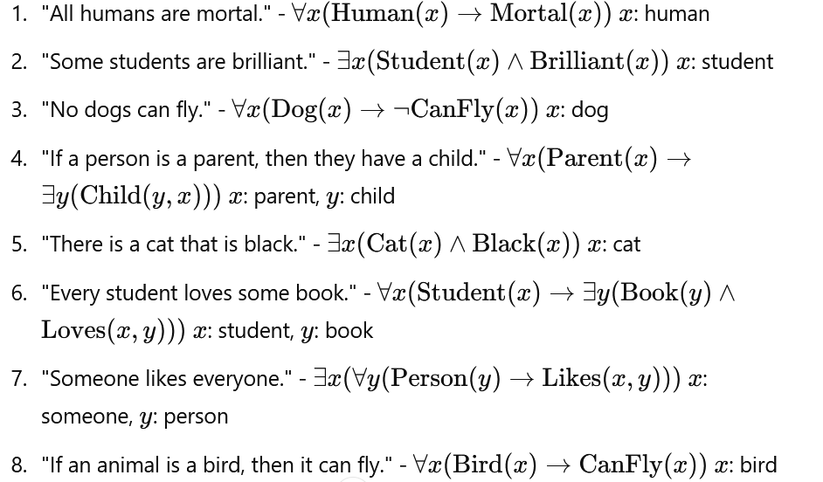

Slide 12
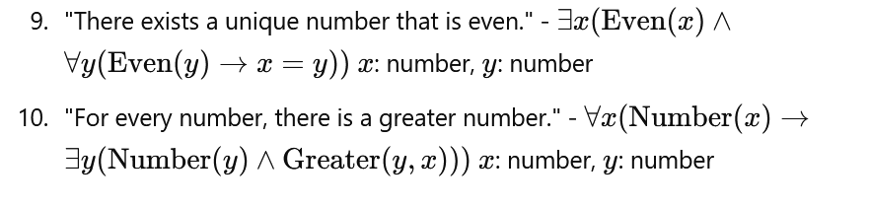

Slide 13
First-Order Logic
CMSC 471
Chapter 8.1-8.3
Adapted from slides by
Tim Finin and
Marie desJardins.
Some material adopted from notes by Andreas Geyer-Schulz

Slide 14
Outline
First-order logic
Properties, relations, functions, quantifiers, …
Terms, sentences, axioms, theories, proofs, …
Extensions to first-order logic
Logical agents
Reflex agents
Representing change: situation calculus, frame problem
Preferences on actions
Goal-based agents

Slide 15
First-order logic
First-order logic (FOL) models the world in terms of
Objects, which are things with individual identities
Properties of objects that distinguish them from other objects
Relations that hold among sets of objects
Functions, which are a subset of relations where there is only one “value” for any given “input”
Examples:
Objects: Students, lectures, companies, cars ...
Relations: Brother-of, bigger-than, outside, part-of, has-color, occurs-after, owns, visits, precedes, ...
Properties: blue, oval, even, large, ...
Functions: father-of, best-friend, second-half, one-more-than ...

Slide 16
User provides
Constant symbols, which represent individuals in the world
Mary
3
Green
Function symbols, which map individuals to individuals
father-of(Mary) = John
color-of(Sky) = Blue
Predicate symbols, which map individuals to truth values
greater(5,3)
green(Grass)
color(Grass, Green)

Slide 17
FOL Provides
Variable symbols
E.g., x, y, foo
Connectives
Same as in PL: not (¬), and (∧), or (∨), implies (→), if and only if (biconditional ↔)
Quantifiers
Universal ∀x or (Ax)
Existential ∃x or (Ex)

Slide 18
Sentences are built from terms and atoms
A term (denoting a real-world individual) is a constant symbol, a variable symbol, or an n-place function of n terms.
x and f(x₁, ..., x_{n}) are terms, where each x_{i} is a term.
A term with no variables is a ground term
An atomic sentence (which has value true or false) is an n-place predicate of n terms
A complex sentence is formed from atomic sentences connected by the logical connectives:
¬P, P∨Q, P∧Q, P→Q, P↔Q where P and Q are sentences
A quantified sentence adds quantifiers ∀ and ∃
A well-formed formula (wff) is a sentence containing no “free” variables. That is, all variables are “bound” by universal or existential quantifiers.
(∀x)P(x,y) has x bound as a universally quantified variable, but y is free.

Slide 19
A BNF for FOL
S := <Sentence> ;
<Sentence> := <AtomicSentence> |
<Sentence> <Connective> <Sentence> |
<Quantifier> <Variable>,... <Sentence> |
"NOT" <Sentence> |
"(" <Sentence> ")";
<AtomicSentence> := <Predicate> "(" <Term>, ... ")" |
<Term> "=" <Term>;
<Term> := <Function> "(" <Term>, ... ")" |
<Constant> |
<Variable>;
<Connective> := "AND" | "OR" | "IMPLIES" | "EQUIVALENT";
<Quantifier> := "EXISTS" | "FORALL" ;
<Constant> := "A" | "X1" | "John" | ... ;
<Variable> := "a" | "x" | "s" | ... ;
<Predicate> := "Before" | "HasColor" | "Raining" | ... ;
<Function> := "Mother" | "LeftLegOf" | ... ;

Slide 20
Quantifiers
Universal quantification
(∀x)P(x) means that P holds for all values of x in the domain associated with that variable
E.g., (∀x) dolphin(x) → mammal(x)
Existential quantification
(∃ x)P(x) means that P holds for some value of x in the domain associated with that variable
E.g., (∃ x) mammal(x) ∧ lays-eggs(x)
Permits one to make a statement about some object without naming it

Slide 21
Quantifiers
Universal quantifiers are often used with “implies” to form “rules”:
(∀x) student(x) → smart(x) means “All students are smart”
Universal quantification is rarely used to make blanket statements about every individual in the world:
(∀x)student(x)∧smart(x) means “Everyone in the world is a student and is smart”
Existential quantifiers are usually used with “and” to specify a list of properties about an individual:
(∃x) student(x) ∧ smart(x) means “There is a student who is smart”
A common mistake is to represent this English sentence as the FOL sentence:
(∃x) student(x) → smart(x)
But what happens when there is a person who is not a student?

Slide 22
Quantifier Scope
Switching the order of universal quantifiers does not change the meaning:
(∀x)(∀y)P(x,y) ↔ (∀y)(∀x) P(x,y)
Similarly, you can switch the order of existential quantifiers:
(∃x)(∃y)P(x,y) ↔ (∃y)(∃x) P(x,y)
Switching the order of universals and existentials does change meaning:
Everyone likes someone: (∀x)(∃y) likes(x,y)
Someone is liked by everyone: (∃y)(∀x) likes(x,y)

Slide 23
Connections between All and Exists
We can relate sentences involving ∀ and ∃ using De Morgan’s laws:
(∀x) ¬P(x) ↔ ¬(∃x) P(x)
¬(∀x) P ↔ (∃x) ¬P(x)
(∀x) P(x) ↔ ¬ (∃x) ¬P(x)
(∃x) P(x) ↔ ¬(∀x) ¬P(x)

Slide 24
Quantified inference rules
Universal instantiation: If a property is true for all elements in a domain, it is true for any specific element in that domain.
∀x P(x) ∴ P(A)
Universal generalization: If a property is true for an arbitrary element in a domain, then it is true for all elements in the domain.
P(A) ∧ P(B) … ∴ ∀x P(x)
Existential instantiation: If there exists an element in a domain for which a property is true, we can infer that the property is true for some specific element.
∃x P(x) ∴P(F)
Existential generalization: If a property is true for some specific element in a domain, then there exists an element in the domain for which the property is true.
P(A) ∴ ∃x P(x)

Slide 25
1. Statement: "All dogs bark."
Inference: "Rover is a dog, so Rover barks.“
2. Observation: "If any student studies hard, they pass the exam."
Generalization: "Therefore, all students who study hard pass the exam.“
3. Statement: "There is someone in the office who can help you."
Inference: "Let's call this person Alex. Alex can help you.“
4. Observation: "Maria can solve the puzzle."
Generalization: "Therefore, there exists someone who can solve the puzzle."

Slide 26
Universal instantiation (a.k.a. universal elimination)
If (∀x) P(x) is true, then P(C) is true, where C is any constant in the domain of x
Example:
(∀x) eats(Ziggy, x) ⇒ eats(Ziggy, IceCream)
The variable symbol can be replaced by any ground term, i.e., any constant symbol or function symbol applied to ground terms only

Slide 27
Existential instantiation (a.k.a. existential elimination)
From (∃x) P(x) infer P(c)
Example:
(∃x) eats(Ziggy, x) → eats(Ziggy, Stuff)
Note that the variable is replaced by a brand-new constant not occurring in this or any other sentence in the KB
Also known as skolemization; constant is a skolem constant
In other words, we don’t want to accidentally draw other inferences about it by introducing the constant
Convenient to use this to reason about the unknown object, rather than constantly manipulating the existential quantifier

Slide 28
Existential generalization (a.k.a. existential introduction)
If P(c) is true, then (∃x) P(x) is inferred.
Example
eats(Ziggy, IceCream) ⇒ (∃x) eats(Ziggy, x)
All instances of the given constant symbol are replaced by the new variable symbol
Note that the variable symbol cannot already exist anywhere in the expression

Slide 29
Translating English to FOL
Every gardener likes the sun.
∀x gardener(x) → likes(x,Sun)
You can fool some of the people all of the time.
∃x ∀t person(x) ∧time(t) → can-fool(x,t)
You can fool all of the people some of the time.
∀x ∃t (person(x) → time(t) ∧can-fool(x,t))
∀x (person(x) → ∃t (time(t) ∧can-fool(x,t))
All purple mushrooms are poisonous.
∀x (mushroom(x) ∧ purple(x)) → poisonous(x)
No purple mushroom is poisonous.
¬∃x purple(x) ∧ mushroom(x) ∧ poisonous(x)
∀x (mushroom(x) ∧ purple(x)) → ¬poisonous(x)
There are exactly two purple mushrooms.
∃x ∃y mushroom(x) ∧ purple(x) ∧ mushroom(y) ∧ purple(y) ^ ¬(x=y) ∧ ∀z (mushroom(z) ∧ purple(z)) → ((x=z) ∨ (y=z))
Clinton is not tall.
¬tall(Clinton)
X is above Y iff X is on directly on top of Y or there is a pile of one or more other objects directly on top of one another starting with X and ending with Y.
∀x ∀y above(x,y) ↔ (on(x,y) ∨ ∃z (on(x,z) ∧ above(z,y)))
Equivalent
Equivalent

Slide 30
Example: A simple genealogy KB by FOL
Build a small genealogy knowledge base using FOL that
contains facts of immediate family relations (spouses, parents, etc.)
contains definitions of more complex relations (ancestors, relatives)
is able to answer queries about relationships between people
Predicates:
parent(x, y), child(x, y), father(x, y), daughter(x, y), etc.
spouse(x, y), husband(x, y), wife(x,y)
ancestor(x, y), descendant(x, y)
male(x), female(y)
relative(x, y)
Facts:
husband(Joe, Mary), son(Fred, Joe)
spouse(John, Nancy), male(John), son(Mark, Nancy)
father(Jack, Nancy), daughter(Linda, Jack)
daughter(Liz, Linda)
etc.

Slide 31
Rules for genealogical relations
(∀x,y) parent(x, y) ↔ child (y, x)
(∀x,y) father(x, y) ↔ parent(x, y) ∧ male(x) (similarly for mother(x, y))
(∀x,y) daughter(x, y) ↔ child(x, y) ∧ female(x) (similarly for son(x, y))
(∀x,y) husband(x, y) ↔ spouse(x, y) ∧ male(x) (similarly for wife(x, y))
(∀x,y) spouse(x, y) ↔ spouse(y, x) (spouse relation is symmetric)
(∀x,y) parent(x, y) → ancestor(x, y)
(∀x,y)(∃z) parent(x, z) ∧ ancestor(z, y) → ancestor(x, y)
(∀x,y) descendant(x, y) ↔ ancestor(y, x)
(∀x,y)(∃z) ancestor(z, x) ∧ ancestor(z, y) → relative(x, y)
(related by common ancestry)
(∀x,y) spouse(x, y) → relative(x, y) (related by marriage)
(∀x,y)(∃z) relative(z, x) ∧ relative(z, y) → relative(x, y) (transitive)
(∀x,y) relative(x, y) ↔ relative(y, x) (symmetric)
Queries
ancestor(Jack, Fred) /* the answer is yes */
relative(Liz, Joe) /* the answer is yes */
relative(Nancy, Matthew)
/* no answer in general, no if under closed world assumption */
(∃z) ancestor(z, Fred) ∧ ancestor(z, Liz)

Slide 32
Axioms for Set Theory in FOL
1. The only sets are the empty set and those made by adjoining something to a set:
∀s set(s) <=> (s=EmptySet) v (∃x,r Set(r) ^ s=Adjoin(s,r))
2. The empty set has no elements adjoined to it:
~ ∃x,s Adjoin(x,s)=EmptySet
3. Adjoining an element already in the set has no effect:
∀x,s Member(x,s) <=> s=Adjoin(x,s)
4. The only members of a set are the elements that were adjoined into it:
∀x,s Member(x,s) <=> ∃y,r (s=Adjoin(y,r) ^ (x=y ∨ Member(x,r)))
5. A set is a subset of another iff all of the 1st set’s members are members of the 2nd:
∀s,r Subset(s,r) <=> (∀x Member(x,s) => Member(x,r))
6. Two sets are equal iff each is a subset of the other:
∀s,r (s=r) <=> (subset(s,r) ^ subset(r,s))
7. Intersection
∀x,s1,s2 member(X,intersection(S1,S2)) <=> member(X,s1) ^ member(X,s2)
8. Union
∃x,s1,s2 member(X,union(s1,s2)) <=> member(X,s1) ∨ member(X,s2)

Slide 33
Semantics of FOL
Domain M: the set of all objects in the world (of interest)
Interpretation I: includes
Assign each constant to an object in M
Define each function of n arguments as a mapping M^{n} => M
Define each predicate of n arguments as a mapping M^{n} => {T, F}
Therefore, every ground predicate with any instantiation will have a truth value
In general there is an infinite number of interpretations because |M| is infinite
Define logical connectives: ~, ^, ∨, =>, <=> as in PL
Define semantics of (∀x) and (∃x)
(∀x) P(x) is true iff P(x) is true under all interpretations
(∃x) P(x) is true iff P(x) is true under some interpretation

Slide 34
Model: an interpretation of a set of sentences such that every sentence is True
A sentence is
satisfiable if it is true under some interpretation
valid if it is true under all possible interpretations
inconsistent if there does not exist any interpretation under which the sentence is true
Logical consequence: S |= X if all models of S are also models of X

Slide 35
Axioms, definitions and theorems
Axioms are facts and rules that attempt to capture all of the (important) facts and concepts about a domain; axioms can be used to prove theorems
Mathematicians don’t want any unnecessary (dependent) axioms –ones that can be derived from other axioms
Dependent axioms can make reasoning faster, however
Choosing a good set of axioms for a domain is a kind of design problem
A definition of a predicate is of the form “p(X) ↔ …” and can be decomposed into two parts
Necessary description: “p(x) → …”
Sufficient description “p(x) ← …”
Some concepts don’t have complete definitions (e.g., person(x))

Slide 36
More on definitions
A necessary condition must be satisfied for a statement to be true.
A sufficient condition, if satisfied, assures the statement’s truth.
Duality: “P is sufficient for Q” is the same as “Q is necessary for P.”
Examples: define father(x, y) by parent(x, y) and male(x)
parent(x, y) is a necessary (but not sufficient) description of father(x, y)
father(x, y) → parent(x, y)
parent(x, y) ^ male(x) ^ age(x, 35) is a sufficient (but not necessary) description of father(x, y):
father(x, y) ← parent(x, y) ^ male(x) ^ age(x, 35)
parent(x, y) ^ male(x) is a necessary and sufficient description of father(x, y)
parent(x, y) ^ male(x) ↔ father(x, y)

Slide 37
More on definitions
S(x) is a necessary condition of P(x)
P(x)
S(x)
(∀x) P(x) => S(x)
S(x) is a sufficient condition of P(x)
S(x)
P(x)
(∀x) P(x) <= S(x)
S(x) is a necessary and sufficient condition of P(x)
P(x)
S(x)
(∀x) P(x) <=> S(x)

Slide 38
Higher-order logic
FOL only allows to quantify over variables, and variables can only range over objects.
HOL allows us to quantify over relations
Example: (quantify over functions)
“two functions are equal iff they produce the same value for all arguments”
∀f ∀g (f = g) ↔ (∀x f(x) = g(x))
Example: (quantify over predicates)
∀r transitive( r ) → (∀xyz) r(x,y) ∧ r(y,z) → r(x,z))
More expressive, but undecidable. (there isn’t an effective algorithm to decide whether all sentences are valid)
First-order logic is decidable only when it uses predicates with only one argument.

Slide 39
Expressing uniqueness
Sometimes we want to say that there is a single, unique object that satisfies a certain condition
“There exists a unique x such that king(x) is true”
∃x king(x) ∧ ∀y (king(y) → x=y)
∃x king(x) ∧ ¬∃y (king(y) ∧ x≠y)
∃! x king(x)
“Every country has exactly one ruler”
∀c country(c) → ∃! r ruler(c,r)
Iota operator: “ι x P(x)” means “the unique x such that p(x) is true”
“The unique ruler of Freedonia is dead”
dead(ι x ruler(freedonia,x))

Slide 40
Notational differences
Different symbols for and, or, not, implies, ...
∀ ∃ ⇒ ⇔ ∧ ∨ ¬ • ⊃
p v (q ^ r)
p + (q * r)
etc
Prolog
cat(X) :- furry(X), meows (X), has(X, claws)
Lispy notations
(forall ?x (implies (and (furry ?x)
(meows ?x)
(has ?x claws))
(cat ?x)))

Slide 41
Logical agents for the Wumpus World
Three (non-exclusive) agent architectures:
Reflex agents
Have rules that classify situations, specifying how to react to each possible situation
Model-based agents
Construct an internal model of their world
Goal-based agents
Form goals and try to achieve them

Slide 42
A simple reflex agent
Rules to map percepts into observations:
∀b,g,u,c,t Percept([Stench, b, g, u, c], t) → Stench(t)
∀s,g,u,c,t Percept([s, Breeze, g, u, c], t) → Breeze(t)
∀s,b,u,c,t Percept([s, b, Glitter, u, c], t) → AtGold(t)
Rules to select an action given observations:
∀t AtGold(t) → Action(Grab, t);
Some difficulties:
Consider Climb. There is no percept that indicates the agent should climb out – position and holding gold are not part of the percept sequence
Loops – the percept will be repeated when you return to a square, which should cause the same response (unless we maintain some internal model of the world)

Slide 43
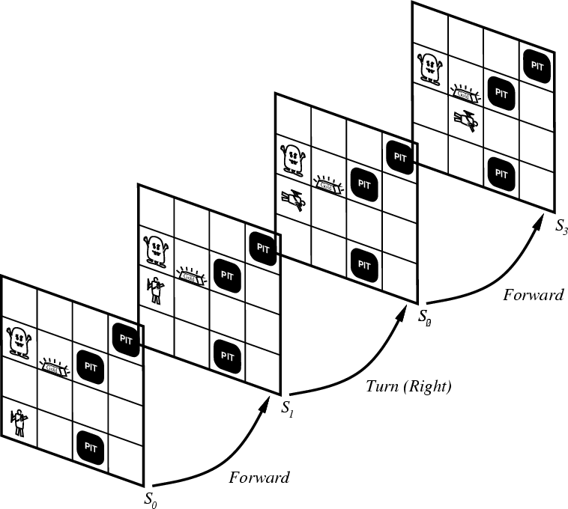
Representing change
Representing change in the world in logic can be tricky.
One way is just to change the KB
Add and delete sentences from the KB to reflect changes
How do we remember the past, or reason about changes?
Situation calculus is another way
A situation is a snapshot of the world at some instant in time
When the agent performs an action A in situation S1, the result is a new situation S2.

Slide 44
Situations

Slide 45
Situation calculus
A situation is a snapshot of the world at an interval of time during which nothing changes
Every true or false statement is made with respect to a particular situation.
Add situation variables to every predicate.
at(Agent,1,1) becomes at(Agent,1,1,s0): at(Agent,1,1) is true in situation (i.e., state) s0.
Alternatively, add a special 2nd-order predicate, holds(f,s), that means “f is true in situation s.” E.g., holds(at(Agent,1,1),s0)
Add a new function, result(a,s), that maps a situation s into a new situation as a result of performing action a. For example, result(forward, s) is a function that returns the successor state (situation) to s
Example: The action agent-walks-to-location-y could be represented by
(∀x)(∀y)(∀s) (at(Agent,x,s) ∧ ¬onbox(s)) → at(Agent,y,result(walk(y),s))

Slide 46
Deducing hidden properties
From the perceptual information we obtain in situations, we can infer properties of locations
∀l,s at(Agent,l,s) ∧ Breeze(s) → Breezy(l)
∀l,s at(Agent,l,s) ∧ Stench(s) → Smelly(l)
Neither Breezy nor Smelly need situation arguments because pits and Wumpuses do not move around

Slide 47
Deducing hidden properties II
We need to write some rules that relate various aspects of a single world state (as opposed to across states)
There are two main kinds of such rules:
Causal rules reflect the assumed direction of causality in the world:
(∀l1,l2,s) At(Wumpus,l1,s) ∧ Adjacent(l1,l2) → Smelly(l2)
(∀ l1,l2,s) At(Pit,l1,s) ∧ Adjacent(l1,l2) → Breezy(l2)
Systems that reason with causal rules are called model-based reasoning systems
Diagnostic rules infer the presence of hidden properties directly from the percept-derived information. We have already seen two diagnostic rules:
(∀ l,s) At(Agent,l,s) ∧ Breeze(s) → Breezy(l)
(∀ l,s) At(Agent,l,s) ∧ Stench(s) → Smelly(l)

Slide 48
Representing change: The frame problem
Frame axioms: If property x doesn’t change as a result of applying action a in state s, then it stays the same.
On (x, z, s) ∧ Clear (x, s) → On (x, table, Result(Move(x, table), s)) ∧ ¬On(x, z, Result (Move (x, table), s))
On (y, z, s) ∧ y≠ x → On (y, z, Result (Move (x, table), s))
The proliferation of frame axioms becomes very cumbersome in complex domains

Slide 49
The frame problem II
Successor-state axiom: General statement that characterizes every way in which a particular predicate can become true:
Either it can be made true, or it can already be true and not be changed:
On (x, table, Result(a,s)) ↔ [On (x, z, s) ∧ Clear (x, s) ∧ a = Move(x, table)] ∧ [On (x, table, s) ∧ a ≠ Move (x, z)]
In complex worlds, where you want to reason about longer chains of action, even these types of axioms are too cumbersome
Planning systems use special-purpose inference methods to reason about the expected state of the world at any point in time during a multi-step plan

Slide 50
Qualification problem
Qualification problem:
How can you possibly characterize every single effect of an action, or every single exception that might occur?
When I put my bread into the toaster, and push the button, it will become toasted after two minutes, unless…
The toaster is broken, or…
The power is out, or…
I blow a fuse, or…
A neutron bomb explodes nearby and fries all electrical components, or…
A meteor strikes the earth, and the world we know it ceases to exist, or…

Slide 51
Ramification problem
Similarly, it’s just about impossible to characterize every side effect of every action, at every possible level of detail:
When I put my bread into the toaster, and push the button, the bread will become toasted after two minutes, and…
The crumbs that fall off the bread onto the bottom of the toaster over tray will also become toasted, and…
Some of the aforementioned crumbs will become burnt, and…
The outside molecules of the bread will become “toasted,” and…
The inside molecules of the bread will remain more “breadlike,” and…
The toasting process will release a small amount of humidity into the air because of evaporation, and…
The heating elements will become a tiny fraction more likely to burn out the next time I use the toaster, and…
The electricity meter in the house will move up slightly, and…

Slide 52
Knowledge engineering!
Modeling the “right” conditions and the “right” effects at the “right” level of abstraction is very difficult
Knowledge engineering (creating and maintaining knowledge bases for intelligent reasoning) is an entire field of investigation
Many researchers hope that automated knowledge acquisition and machine learning tools can fill the gap:
Our intelligent systems should be able to learn about the conditions and effects, just like we do!
Our intelligent systems should be able to learn when to pay attention to, or reason about, certain aspects of processes, depending on the context!

Slide 53
Preferences among actions
A problem with the Wumpus world knowledge base that we have built so far is that it is difficult to decide which action is best among a number of possibilities.
For example, to decide between a forward and a grab, axioms describing when it is OK to move to a square would have to mention glitter.
This is not modular!
We can solve this problem by separating facts about actions from facts about goals. This way our agent can be reprogrammed just by asking it to achieve different goals.

Slide 54
Preferences among actions
The first step is to describe the desirability of actions independent of each other.
In doing this we will use a simple scale: actions can be Great, Good, Medium, Risky, or Deadly.
Obviously, the agent should always do the best action it can find:
(∀a,s) Great(a,s) → Action(a,s)
(∀a,s) Good(a,s) ∧ ¬(∃b) Great(b,s) → Action(a,s)
(∀a,s) Medium(a,s) ∧ (¬(∃b) Great(b,s) ∨ Good(b,s)) → Action(a,s)
...

Slide 55
Preferences among actions
We use this action quality scale in the following way.
Until it finds the gold, the basic strategy for our agent is:
Great actions include picking up the gold when found and climbing out of the cave with the gold.
Good actions include moving to a square that’s OK and hasn't been visited yet.
Medium actions include moving to a square that is OK and has already been visited.
Risky actions include moving to a square that is not known to be deadly or OK.
Deadly actions are moving into a square that is known to have a pit or a Wumpus.

Slide 56
Goal-based agents
Once the gold is found, it is necessary to change strategies. So now we need a new set of action values.
We could encode this as a rule:
(∀s) Holding(Gold,s) → GoalLocation([1,1]),s)
We must now decide how the agent will work out a sequence of actions to accomplish the goal.
Three possible approaches are:
Inference: good versus wasteful solutions
Search: make a problem with operators and set of states
Planning: to be discussed later

